Slide 1

Statistical and Predictive Modelling for Analytics II
Final Project – DATA 2204
Presented By
Kartik Sojitra (100723768)

Slide 2

Table of Contents
Executive Summery
Dataset Summary
Model Selection
Key Findings
Model Evaluation
Conclusion
Recommendations
Appendix
References

Slide 3

Executive Summary
Mr. John Hughes wants to determine that which algorithm will be more successful to identify the heart disease.
By statistical learning methods, I would be identifying the findings and outcomes
Dataset contains 13 independent variable and 1 target variable (heart disease) and the highly correlated.
The model would help for solving problem statement and lastly recommendation from the analysis would be provided to help medical industry to implement.

Slide 4
Problem Statement
To make model which helps Mr. John Hughes to identify heart disease in the medical industry.
Statistical and predictive modeling using different algorithms to solve regression and classification problems based on outcomes.
The modelling is done to minimize trade offs, low bias and fitting the data for better accurate model.
Cont..

Slide 5
Modelling helps in solving problems and decision making based on the positive or negative outcomes or doing further analysis.
Here, logistical regression and decision tree classifier with 3 ensemble techniques (voting, stacking and AdaBoost) would help in determining the fraudulent behaviour and how the variables impacts on them.
Pandas is used for understanding basic statistical details i.e. count, mean, standard deviation and percentile.

Slide 6
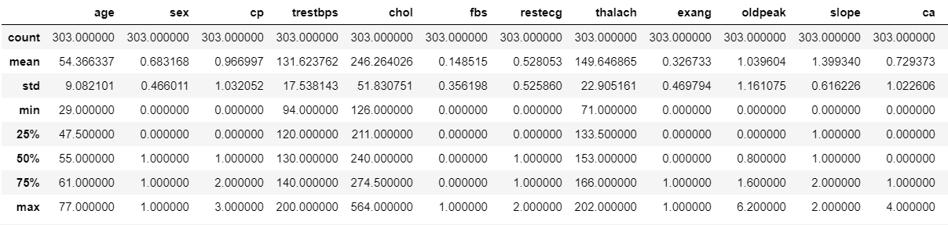
Key Statistics
The dataset describes the overall statistical details of each variables.
Pandas as packaging import and analyze data very simply.
Pandas is used for understanding basic statistical details i.e. count, mean, std and percentile.

Slide 7
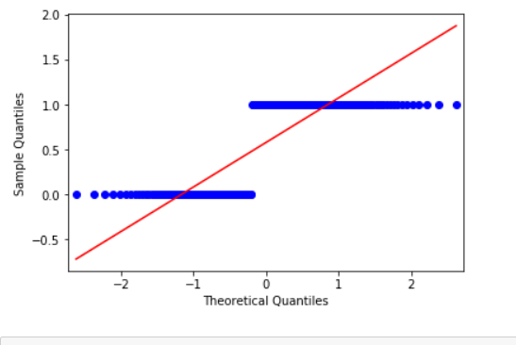
Q-Q Plot
The QQ-plot determines that values of Utility do not adapt very well to the normal distribution.
The variation between Utility values and the normal distribution shows to be most noted in the lower left-hand angle of the chart, which compares to the left end of the normal distribution.
The inconsistency is remarkable in the uppermost right and left-hand edge of the diagram, which resembles abnormal distribution.

Slide 8
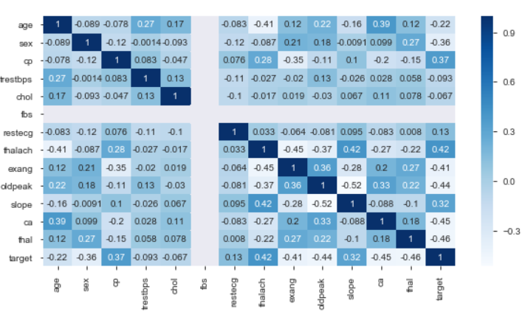
Heat Map
Heat Map shows the correlation between the independent variables.
It also specifies that what makes a good model, how can we validate and optimized the model and which hyperparameter we used to improve the accuracy of the model.
Moreover, we can use visualization to understand the correlation between variables.
From the correlation matrix graph, we can see that ‘cp’ has strong correlation with ‘target’ by 37% whereas with ‘thalach’ its correlated by 42%. Additionally, ‘Chol’ and ‘trestbps’ has not good correlation with ‘target’, -0.067 and -0.093 respectively.

Slide 9
Steps to conduct Analysis
Tukey Method
Importing Libraries
Load Dataset
Remove NA
Run Model
Create Voting Model
SMOTE
Scale Variables
Cont..

Slide 10
Model Selection
Models to be build were chosen according to the type of dependent factor. I this case, it has only two possible results best and others and we have close dataset, so we have chosen logistic regression model as our base model.
Logistic Regression is a Machine Learning classification algorithm that is applied to predict the probability of a categorical dependent variable.
In logistic regression, the dependent variable is a binary variable that contains data coded as best (1) and other (0). In other words, the logistic regression model predicts P(Y=1) as a function of X.

Slide 11
Logistic Regression Model
Logistic Regression is a Machine Learning classification algorithm that is applied to predict the probability of a categorical dependent variable.
In logistic regression, we are using confusion matrix to find the accuracy of the model and avoid overfitting.
we are only concerned about the probability of outcome dependent variable ( success or failure) in the logistics regression.

Slide 12
Random Forest
It is used to solve regression problems and in decision tree for fitting training data.
It is trained by bagging method. Moreover, it randomly sampling subset of each training data and fits the model into smaller datasets and makes predictions.
Random forest is done for entire dataset into train and test, and it help in reducing bias and remove unscaled features from the model.
Bagging and boosting is used for complex model and inherent variance and bagging works well in complex model with high bias model.

Slide 13
Decision Tree
A decision tree is a type of supervised learning algorithm that is mostly used in classification problems.
It works for both categorical and continuous input and output variables and It can handle both numerical and categorical variables.
Decision trees have no assumptions about space distribution and the classifier structure.

Slide 14
Extra Trees Model
Extra Trees Algorithm
An “extra trees” classifier, otherwise known as an “Extremely randomized trees” classifier, is a variant of a random forest. Unlike a random forest, at each step the entire sample is used, and decision boundaries are picked at random, rather than the best one. In real world cases, performance is comparable to an ordinary random forest, sometimes a bit better.

Slide 15
Performance Comparison
Here the performance table shows that every model’s outcomes to be almost same score. However, Logistic regression model outcome seems to be highest as 0.83 and decision trees to be lowest as 0.77.
Logistic Regression Model | Random Forest Model | Decision Tree Model | Extra Trees Model
0.83 +/- 0.05 | 0.80 +/- 0.03 | 0.77 +/-0.04 | 0.81 +/- 0.03
Notes:
Corresponding visuals to these outcomes like the learning curve for output variable are available in the appendix

Slide 16
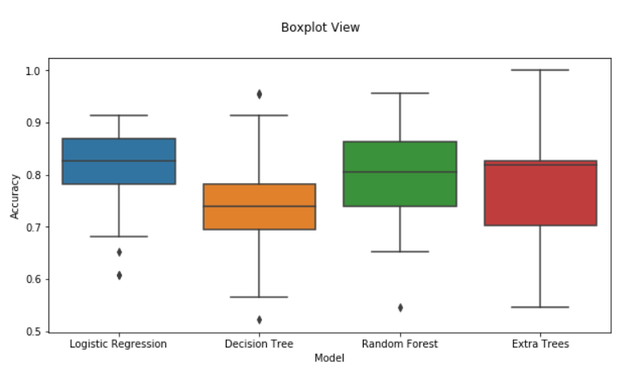
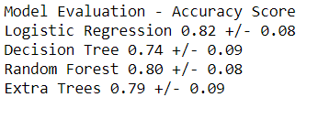
Model Evaluation
Logistic regression model has the highest accuracy of 0.82 among all models. Based on the outcomes for both optimization model, considering logistics regression to be considered as the best model. However, random forest also gives good accuracy.

Slide 17
NestedCV of Models
Nested cross-validation is often used to train a model in which hyperparameters also need to be optimized.
Model selection without NestedCV uses the same data to tune model parameters and evaluate model performance. It is executed by GridSearch.
To avoid the problem, NestedCV uses a series of training data. The score is maximized by fitting a model to each training set and then directly maximized in selecting hyperparameter over the validation set.
Notes:
Corresponding visuals to these outcomes like the NestedCV for output variable are available in the appendix

Slide 18
ROC Curve of Logistic Regression Model
ROC summarizes the logistic regression model’s performance by evaluating the trade offs between true positive rate and false positive rate.
AUC is a perfect performance metric for ROC curve of all models. Higher the area under curve, better the prediction power of the model.
In the graph, AUC of the ROC for Logistic regression curve is 0.91 which is closed to 1 that evaluates how well a logistic regression model classifies positive and negative outcomes at all possible cutoffs.
Notes:
Corresponding visuals to these outcomes like the ROC curve for output variable are available in the appendix

Slide 19
Conclusion
Considering all model evaluation, logistic regression gives best accuracy to the model using random forest, stacking, voting and AdaBoost ensemble techniques.
Mr. John Hughes can use logistic regression model to identify the heart disease because it works very well in binomial classification.
Due to adding hyperparameters to the model for optimization algorithm removes redundancy and biasness to the model.
In addition, for the smaller dataset, simple model can give better accuracy towards model and make good predictions.
Finally, for the larger dataset and complex models, ensembled models gives more accurate score to model and predictions.

Slide 20
Recommendations
Mr. John Hughes should add some variable to create high accuracy in the model and should train the x and y better which builds good model.
To improve the accuracy of optimizing the regularization models and avoid problem of overfitting, Mr. John Hughes can collect more training data and reduce the complexity of the model.
Multiple data can also help to correlate between the data and variables, more inputs would help to create high level model.
The accuracy of this model is 0.83 which demonstrates that the logistic regression model is good to predict positive and negative change in Target (heart disease).

Slide 21
Appendix : Key Statistics

Slide 22
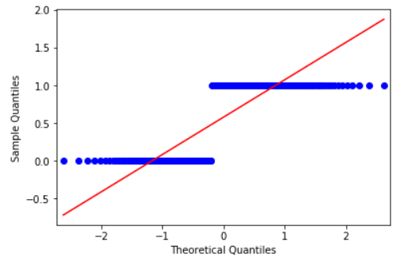
Appendix : (Q-Q Plot)

Slide 23
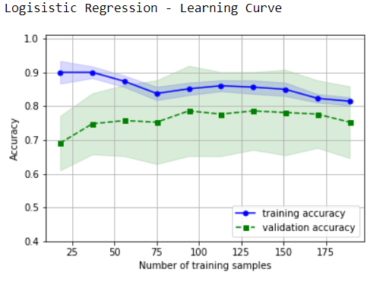
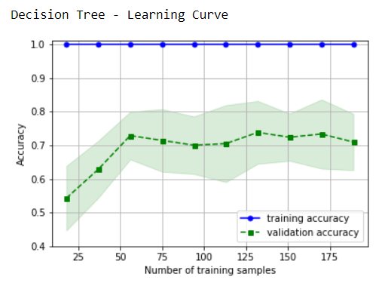
Appendix : Learning Curve

Slide 24
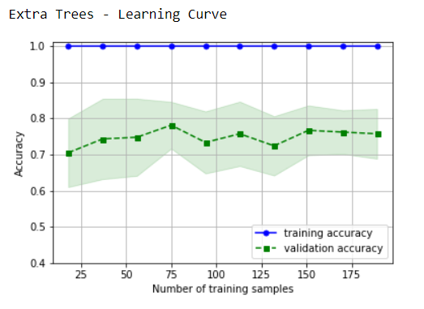
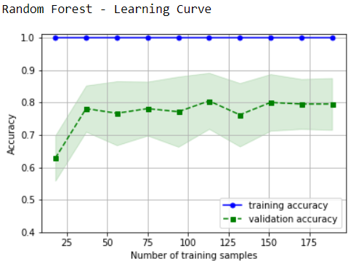
Appendix : Learning Curve

Slide 25
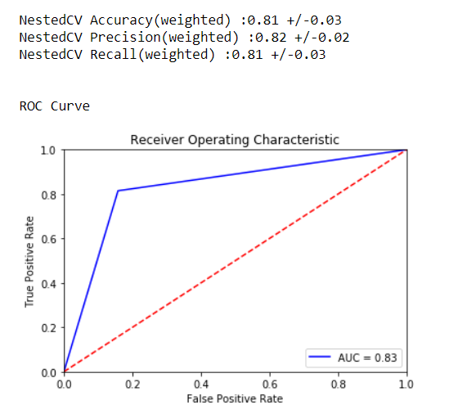
ROC Curve of Extra Tree Classifier

Slide 26
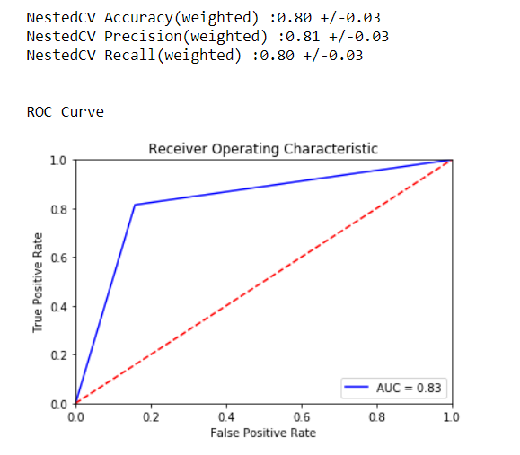
ROC Curve of Random Forest Model

Slide 27
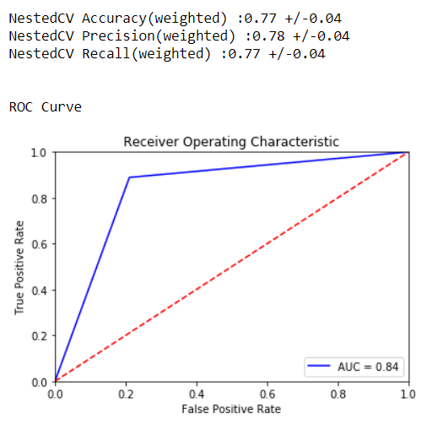
ROC Curve of Decision Tree

Slide 28
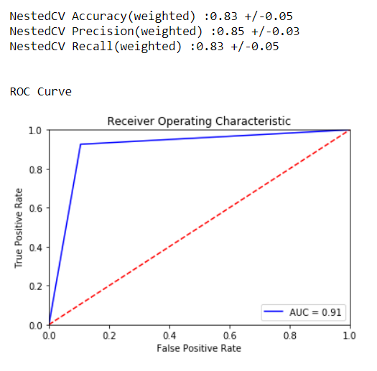
ROC Curve of Logistic Regression Model

Slide 29
References
Sam Plati_DATA 2204_Final Assignment Tips Guidelines
Sam Plati_DATA 2204_Weekly Deliverables

Slide 30


